Slide 1


Cheryl Crispo
15 April 2024

Slide 2

Outline
Executive Summary
Introduction
Methodology
Results
Conclusion
Appendix

Slide 3
Executive Summary
Data was collected via API calls and web scraping to obtain data for launches for SpaceX. Data was wrangled and normalized via a variety of techniques including SQL queries and visualizations to interpret the data
Predictive analysis was used to establish machine learning accuracy and was found to be 84.6% accurate.
The exploratory data analysis shows a distinct preference for four launch sites, payloads and orbit for a successful mission.
The analysis also shows that success has rapidly increased since 2013 and the data support interrogation of payloads, success rates and launch sites for improved decision making

Slide 4
Introduction
The context of this project is to predict if the Falcon 9 first stage will land successfully.
Due to the cost involved in launching a mission, a cost of 62 million dollars, there is a significant cost difference to other providers. If it can be determined if the first stage will land, the cost of a launch can be determined.
This information can be used if an alternate company wants to bid against SpaceX for a rocket launch.
The model is used to find what factors contribute to a successful launch including payload mass, launch site and orbit.

Slide 5

Section 1

Slide 6
Methodology
Executive Summary
Data was collected via API calls and web scraping.
The data was processed via several methods, including wrangling methodologies, to ensure data was normalized and empty fields were amended.
Exploratory data analysis (EDA) using visualization and SQL to establish baselines and parameters to interpret the data easily
Folium and Plotly Dash were utilized to review individual launch site data
Predictive analysis was used to establish machine learning accuracy

Slide 7
Data Collection
The data was extracted via API calls and also web scraping of a website to add additional data to the dataset.
API calls:
The data was turned into a pandas data frame and normalized
Data was reviewed for missing or null values and amended as necessary
Web scraping
BeautifulSoup was utilized to perform the selection of relevant tables from a website containing Falcon 9 launches
Data was parsed and converted to a data frame

Slide 8
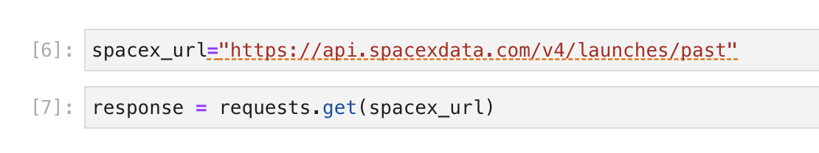
Data Collection – SpaceX API
The dataset API URL is assigned a variable (spacex_url)
From the imported module Requests, assign the URL to a variable, response
From response, the data is manipulated
Github: https://github.com/purplerome/finalassignment/blob/main/jupyter-labs-spacex-data-collection-api%20(2).ipynb

Slide 9
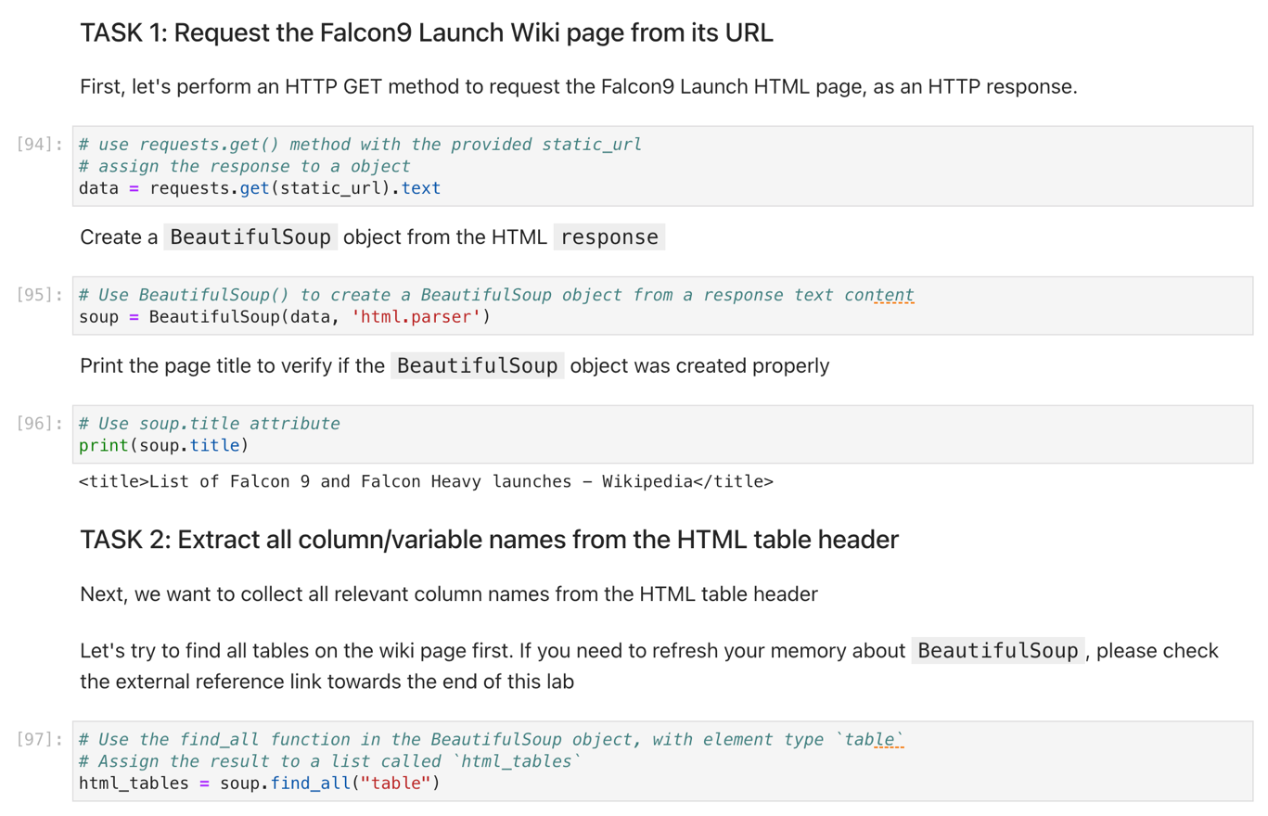
Data Collection - Scraping
The webpage is scraped to find tables contained within the table
The imported module BeautifulSoup uses its function to select the required table
The table is converted to a data frame and then manipulated to obtain relevant data
Github: https://github.com/purplerome/finalassignment/blob/main/jupyter-labs-webscraping%20(2).ipynb

Slide 10
Data Wrangling
The dataset was reviewed to analyze the success (either successful or unsuccessful) launches from each of the launch sites compared to the payload mass of each flight.
The data was reviewed to ensure that the data within the dataset to identify gaps in the data including which columns have null values, and the identified types of each column. The overall goal was to ensure that these values were identified and rectified, if needed, in further stages.
In addition, an additional column was added to the dataset as a classification variable. The variable, Class, was added to categorize a launch as successful or unsuccessful to assist in further analysis.
GitHub: https://github.com/purplerome/finalassignment/blob/main/labs-jupyter-spacex-Data%20wrangling%20(2).ipynb

Slide 11
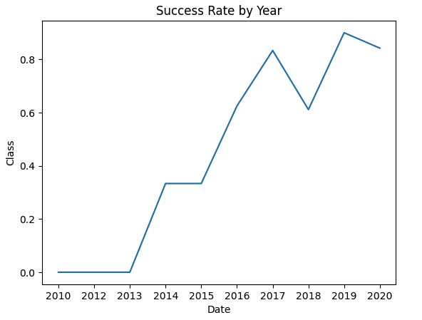
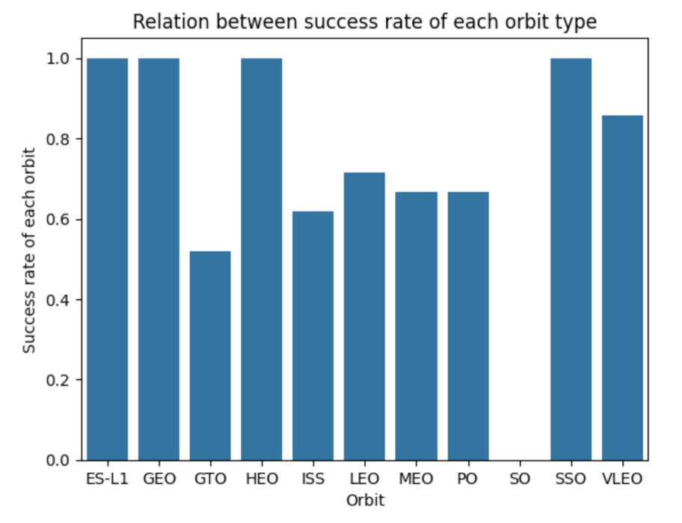
EDA with Data Visualization
Data was visualized to review the data in terms of launch site and flight details
As can be seen the success rate has increased steadily since 2013 indicating the improvements in the launch procedures
Additionally, four orbits are showing higher success rates than others indicating that further work may need to be done for these orbits.
GitHub: https://github.com/purplerome/finalassignment/blob/main/edadataviz%20(1).ipynb

Slide 12
EDA with SQL
The following SQL queries were performed to analyze the data:
Total payload mass in kg for the customer NASA (CRS)
Average payload mass for the booster F9 v1.1
The first date that a successful (ground pad) landing was achieved
The boosters that were within a specific payload mass range and successful outcome in Drone Ship
The total number of successful and failure mission outcomes
The booster versions that carried the maximum payload mass
Ranking of the landing outcomes by success factor
GitHub: https://github.com/purplerome/finalassignment/blob/main/edadataviz%20(1).ipynb

Slide 13
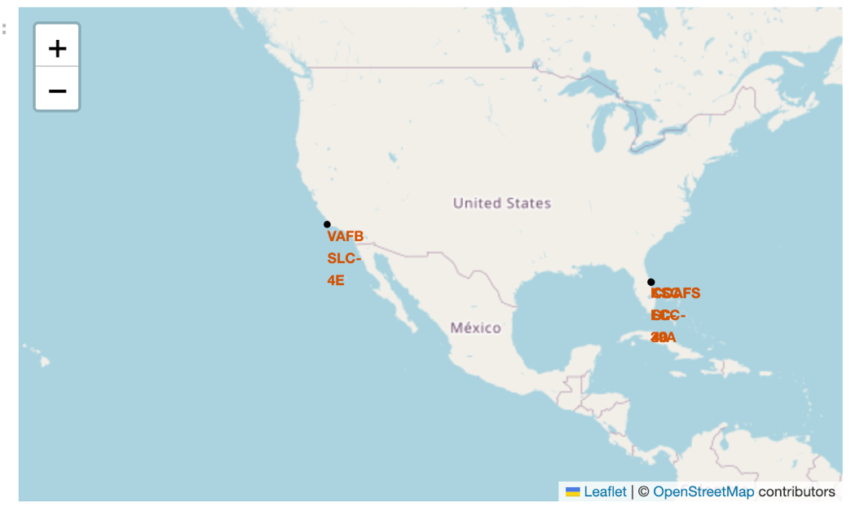
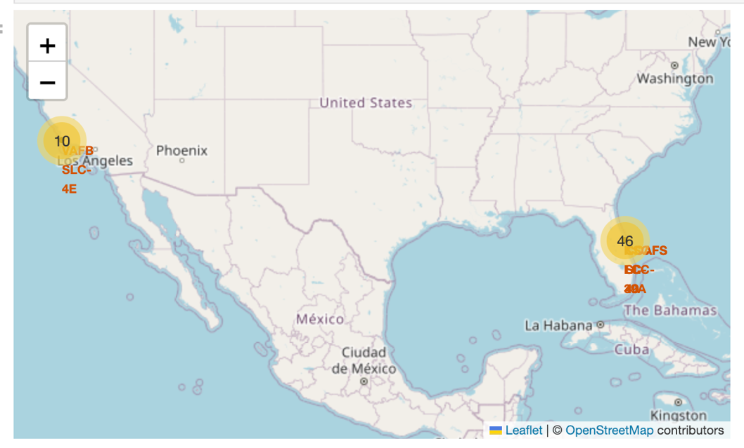
Build an Interactive Map with Folium
Folium maps were generated for the launch site data.
As each location has multiple launch sites located in close proximity, a mixture of marker clusters and circles were used to assist the user in zooming in on particular areas thereby decreasing the noise on the map.
GitHub: https://github.com/purplerome/finalassignment/blob/main/lab_jupyter_launch_site_location%20(3).ipynb

Slide 14
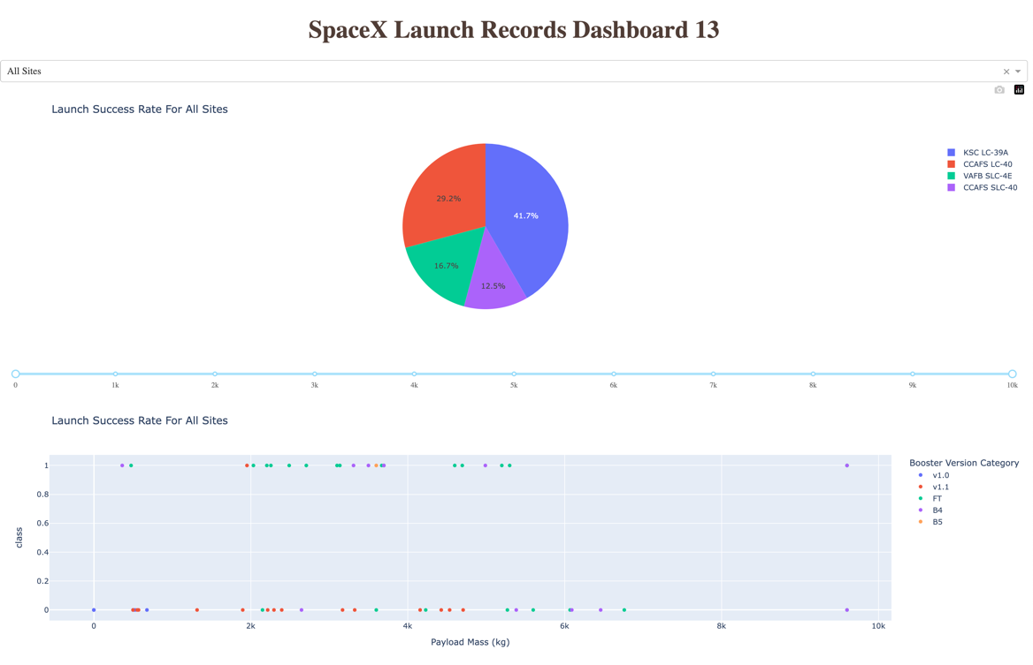
Build a Dashboard with Plotly Dash
The dashboard has been populated with 2 graphs: launch success by site, and launch success rate by booster.
The graphs can be analyzed for overall outcomes, and by individual launch site
The analyst can review overall outcomes and interrogate data individual site data for further minute analysis.
GitHub: https://github.com/purplerome/finalassignment/blob/main/spacex_dash.py

Slide 15
Predictive Analysis (Classification)
The data was modelled in NumPy with training and test data ready for logistic regression
The regression was evaluated using GridSearchCV and fitted with the training subset
The model’s accuracy was checked via confusion matrices and estimators for SVC, Decision Tree Classifier, and nearest neighbor.
All of these methods produce the same results, within 1% with confusion matrices and scoring accuracy.

Slide 16
Results
The exploratory data analysis shows a distinct preference for four launch sites, payloads and orbit for a successful mission.
The analysis also shows that success has rapidly increased since 2013
The interactive dashboards can be manipulated for individual team member of analysis of individual launch sites which will assist in choosing the most appropriate launch site and payloads for future missions
The predictive analysis indicates that the model is 84.6% accurate.

Slide 17

Section 2

Slide 18
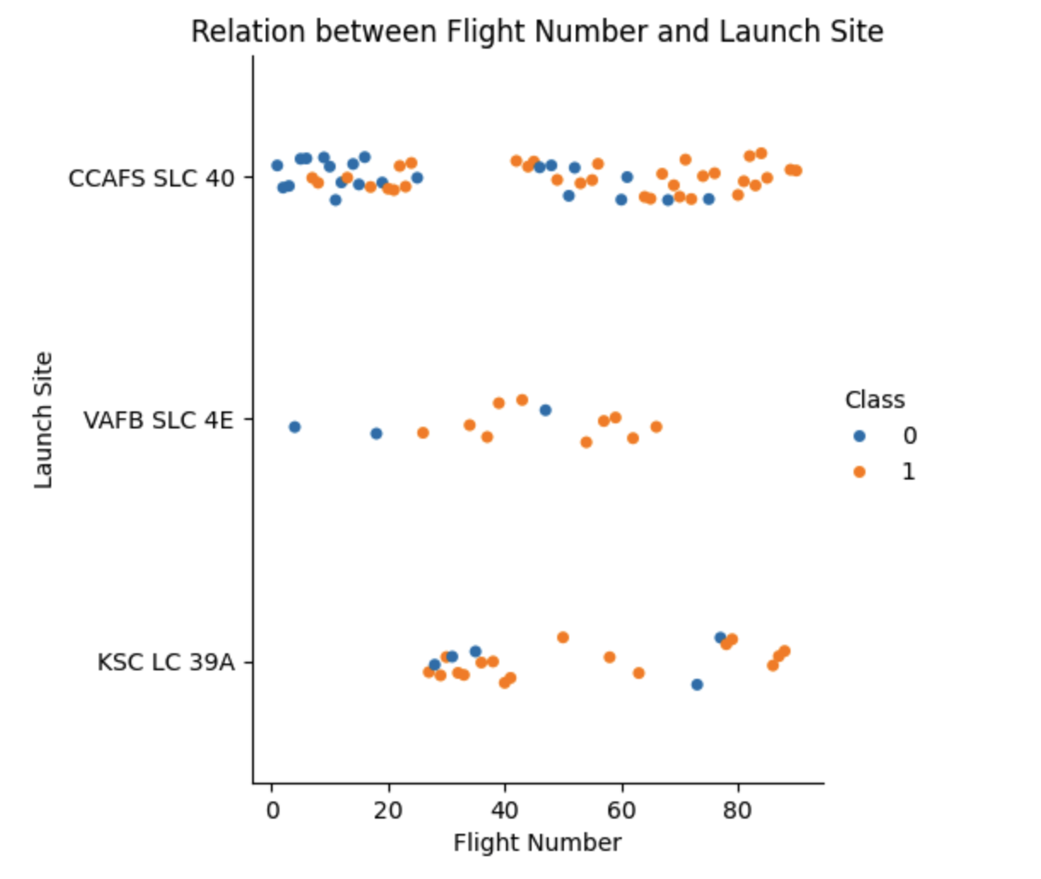
Flight Number vs. Launch Site
The analysis shows that the more missions from a launch site, there is a higher degree of success.

Slide 19
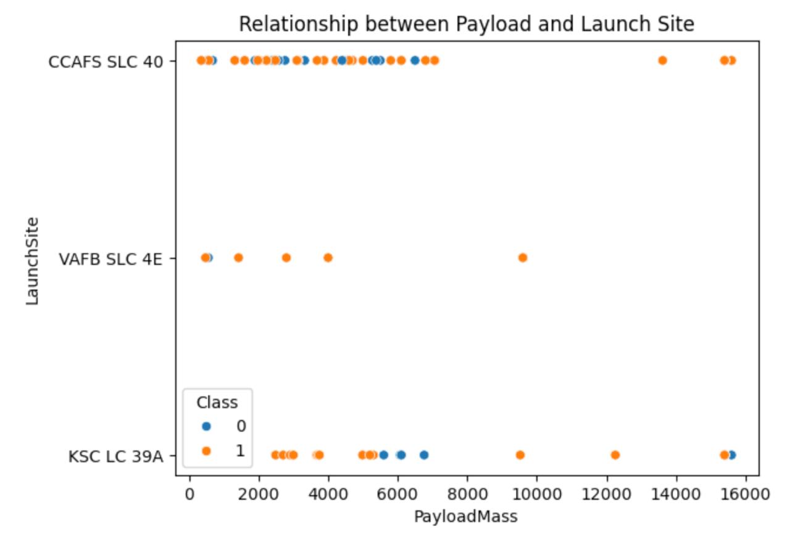
Payload vs. Launch Site
The plot indicates that predominantly the launches have been less than 8000 kg.
There are outliers above this level with only one being unsuccessful
VAFB SLC 4E has only been used sparingly but also with lower payload size.

Slide 20
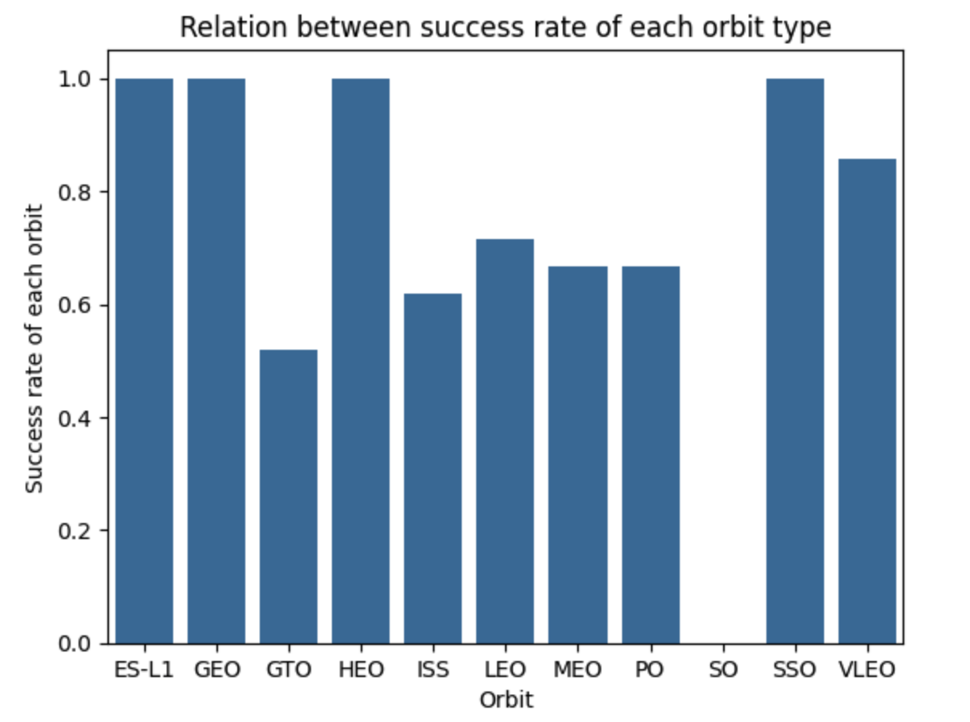
Success Rate vs. Orbit Type
The figure indicates that the following launch sites have the highest success rates:
ES-L1
GEO
HEO
SSO
The remainder of the sites, except for SO, achieved over 50% success rates.

Slide 21
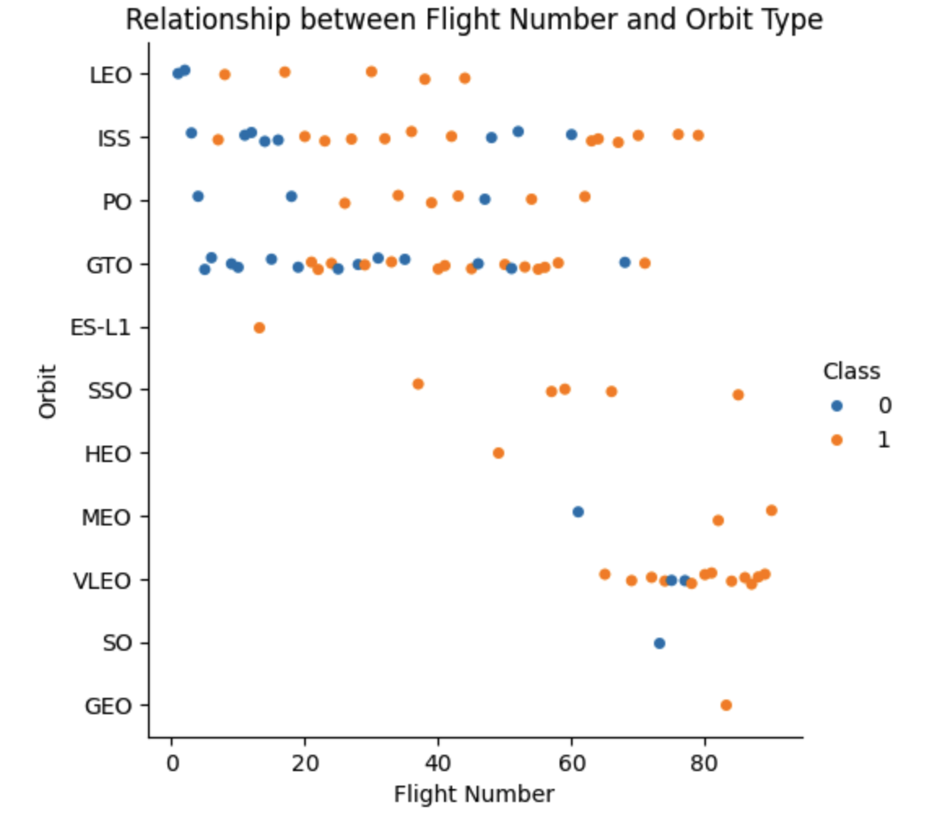
Flight Number vs. Orbit Type
The plot indicates that the greatest use comes from the GTO orbit
The graph shows that some orbits, LEO, ISS, PO and GTO are the most often utilised with varying levels of success.

Slide 22
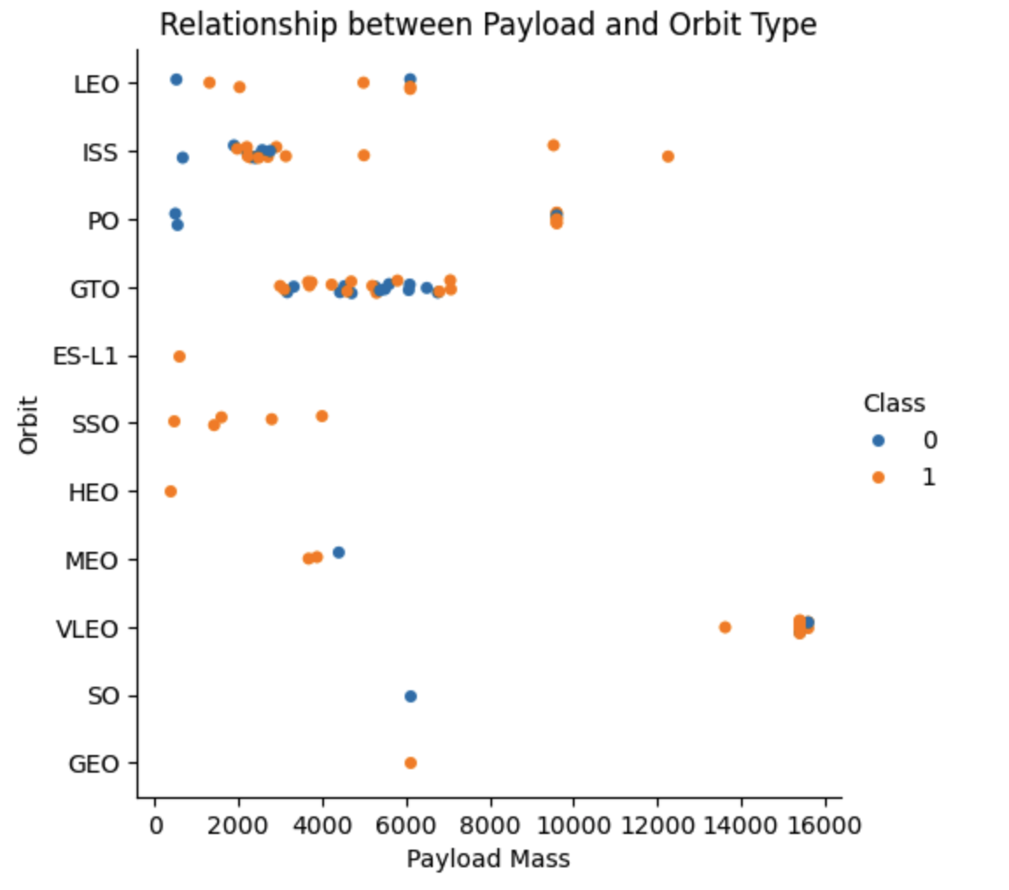
Payload vs. Orbit Type
The plot shows that VLEO and ISS are the most successful for higher payloads.
GTO appears to be the most widely used method for payloads between 4000 and 8000 kg, but its success rate is low.

Slide 23
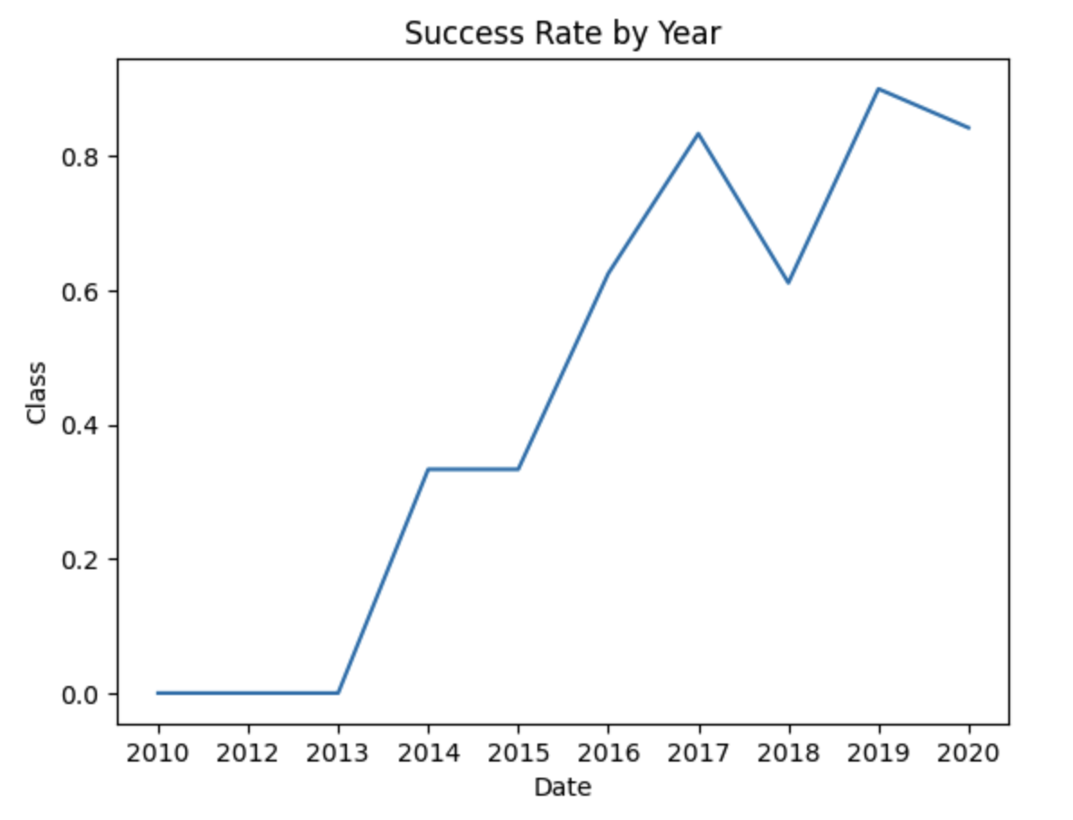
Launch Success Yearly Trend
In the first three years, the success rate was zero
In subsequent years, there has been a steady increase in success rates

Slide 24
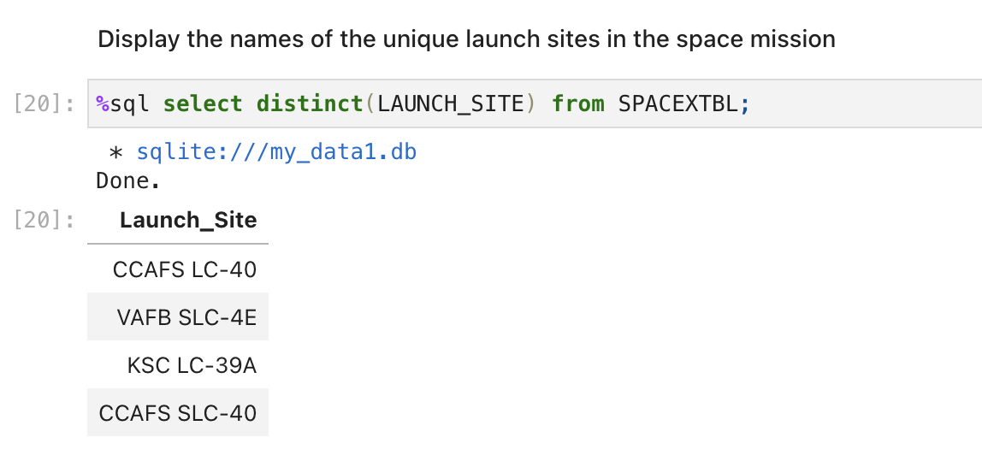
All Launch Site Names
An SQL query was generated to select each unique launch site utilizing the select DISTINCT query language

Slide 25
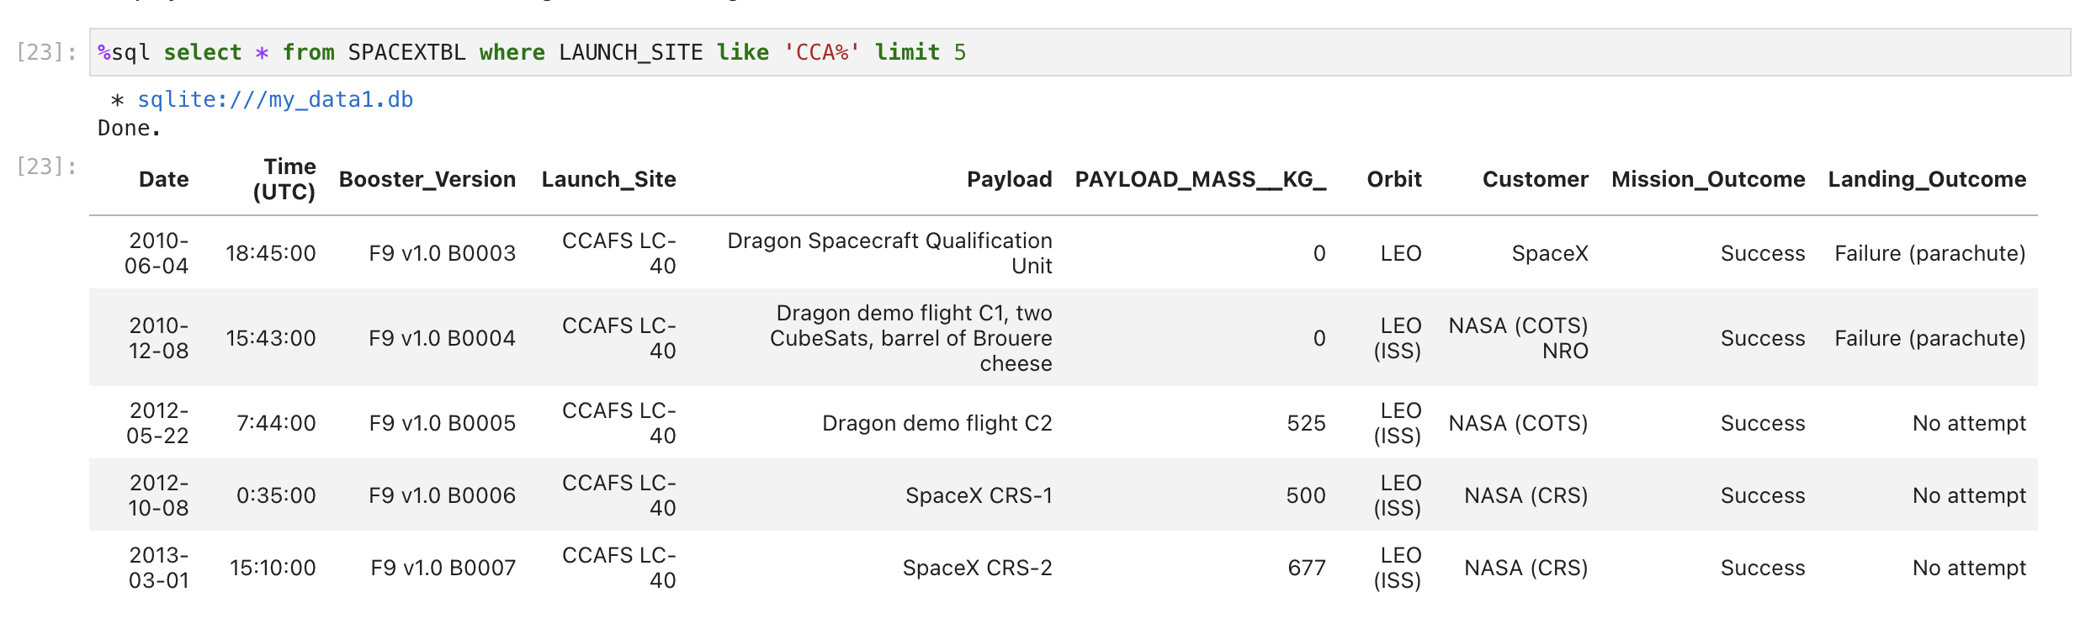
Launch Site Names Begin with 'CCA'
A query was run to find five missions that have emanated from sites starting with CCA – results are as below

Slide 26
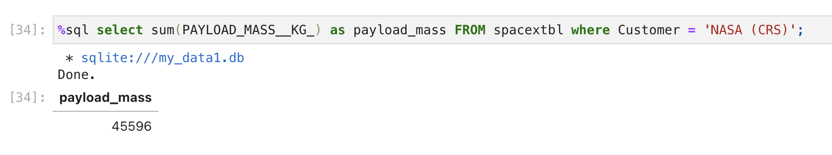
Total Payload Mass
The total payload mass for missions from the customer NASA (CRS), totals 45596.
The query calculates the sum of the payloads with the customer of NASA (CRS)

Slide 27
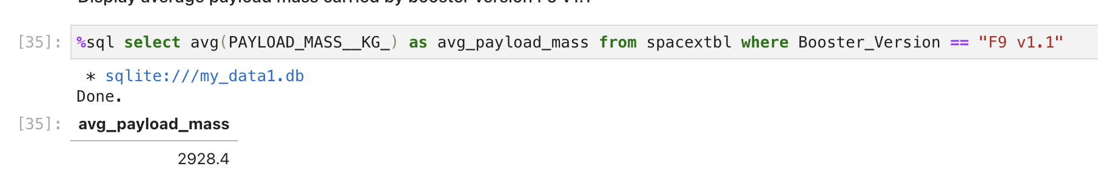
Average Payload Mass by F9 v1.1
The average payload mass in kg where the booster version is F9 v1.1 is 2928.4
The data is obtained from an SQL query averaging the payload mass where the booster version is F9 v1.1

Slide 28
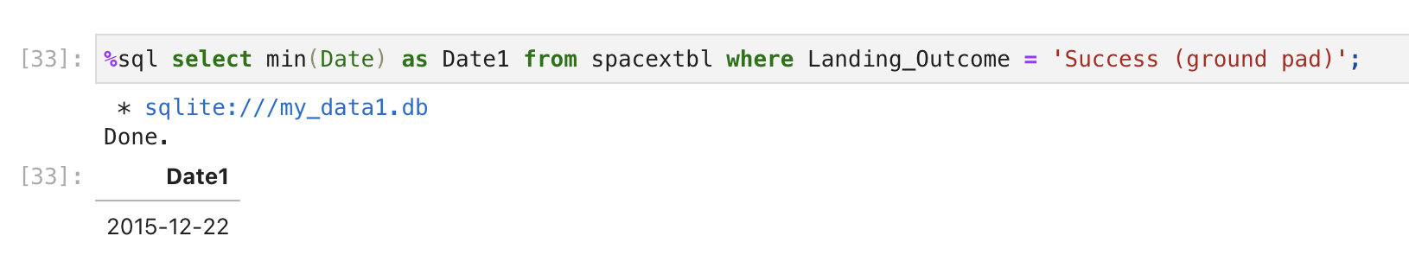
First Successful Ground Landing Date
The first successful landing outcome was on 22 December 2015
The data is obtained from an SQL query where the minimum date is calculated from the data set where the landing outcome is Success (ground pad)

Slide 29
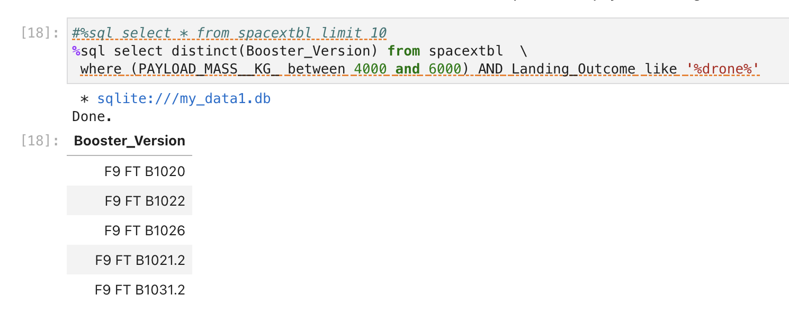
Successful Drone Ship Landing with Payload between 4000 and 6000
There are five booster versions that had a successful drone landing with payloads between 4000 and 6000
The data is obtained from an SQL query where unique values of booster version were obtained where payload mass was between 4000 and 6000 and landing outcome contained the word drone.

Slide 30
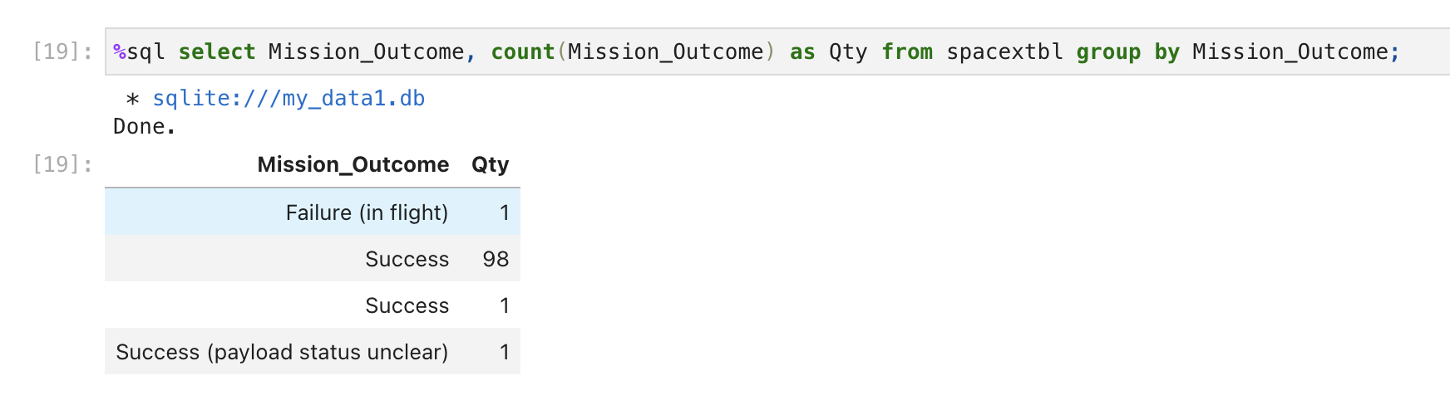
Total Number of Successful and Failure Mission Outcomes
The table below shows the number of mission outcomes from the data set
The data is obtained from an SQL query based on Mission Outcome and the count of each outcome

Slide 31
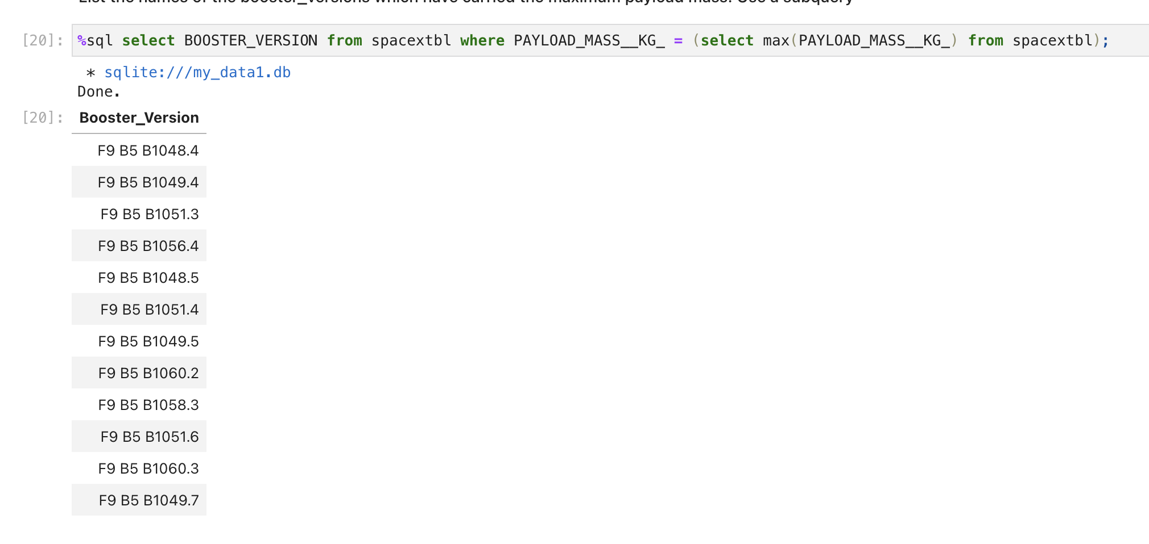
Boosters Carried Maximum Payload
The table below shows the boosters that have carried the maximum payload
The data is obtained from selecting the booster version with the maximum payload in the data set by using the Max function

Slide 32
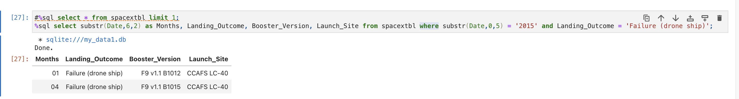
2015 Launch Records
The table below shows the launch records from 2015 indicating two missions occurred, both unsuccessful, during this time
The data is obtained from an SQL query based on a substring of the year, the landing outcome, the booster version and the launch site

Slide 33
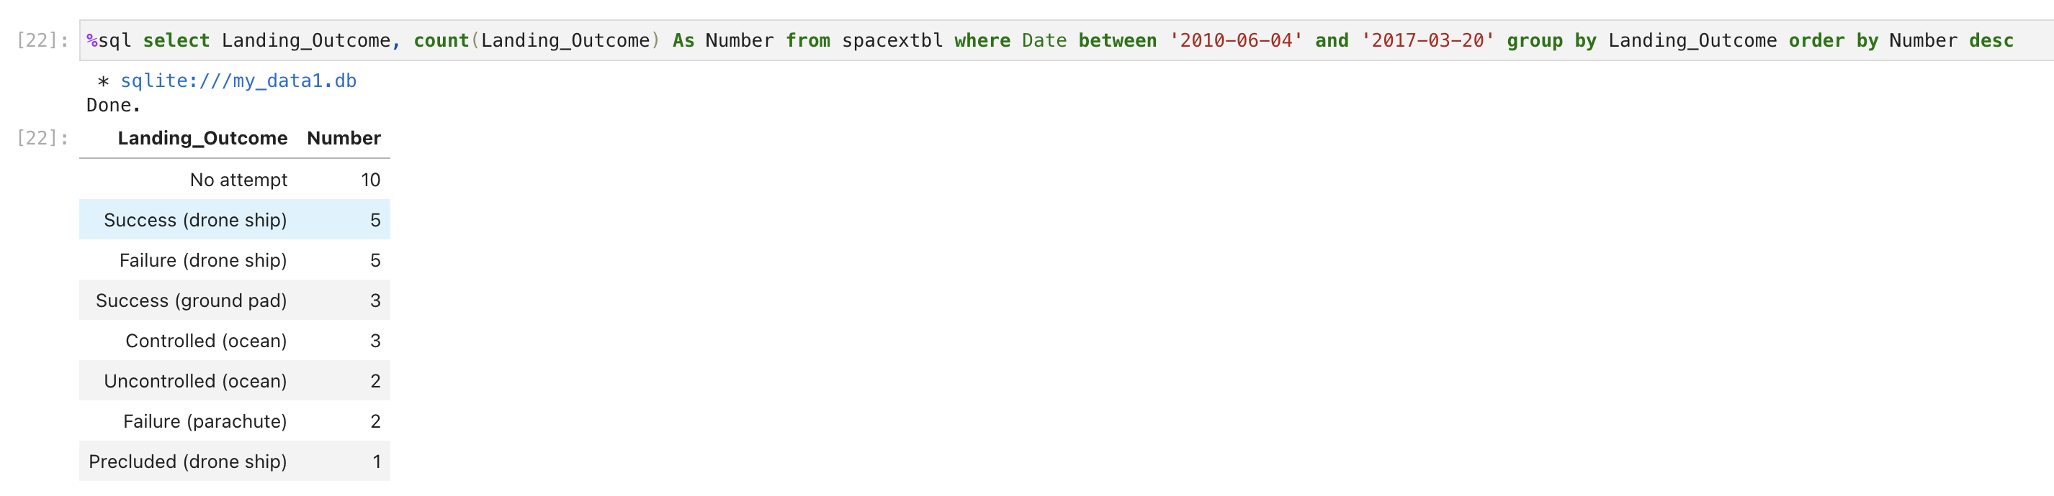
Rank Landing Outcomes Between 2010-06-04 and 2017-03-20
The table below shows the count of landing outcomes between the date 2010-06-04 and 2017-03-20, in descending order
The data is obtained from an SQL query based on landing outcome and the count of each outcome between a set of dates

Slide 34

Section 3

Slide 35
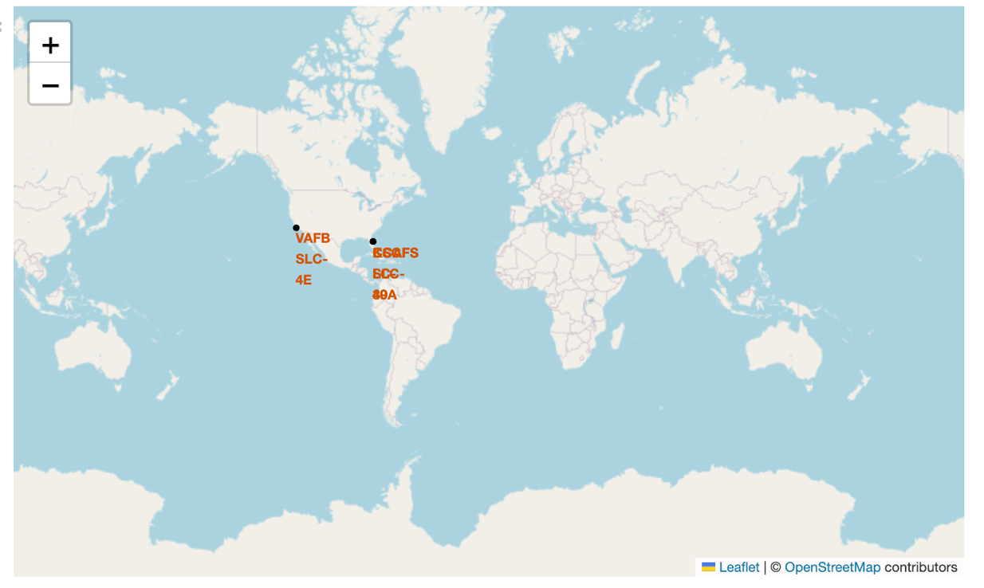
Launch Sites Global Map
The launch sites are all located in the United States and near the coast
There are multiple launch sites in close proximity

Slide 36
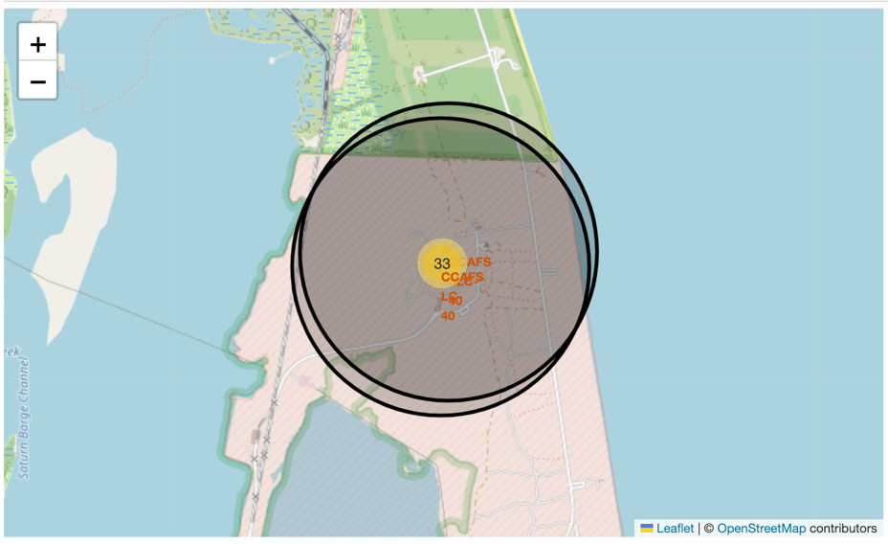
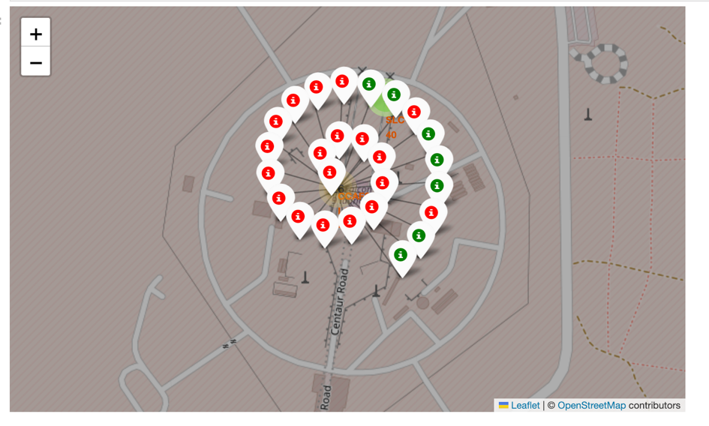
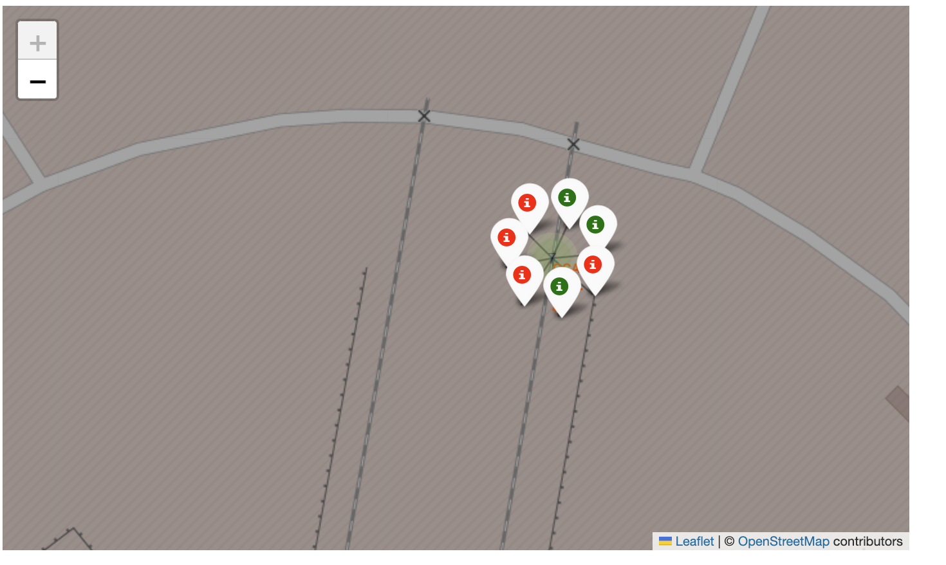
Launches by Success Outcome
The maps indicate for two launch sites the success and failure of each launch
The map to the right is the zoomed-out version of the launch site.
Once interrogated, the launch site is further interrogated. The green icons indicate successful launches, whilst the red icons indicate unsuccessful launches.

Slide 37
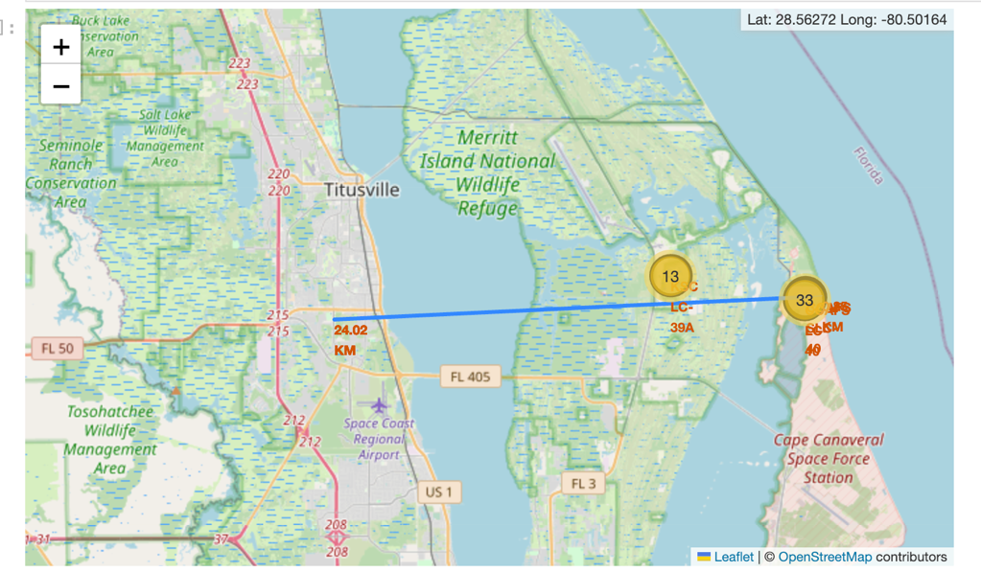
Distance to a Local Area
A folium map was produced by selecting a local landmark and the distance calculated between a launch site and the location
A line indicates the direct line between the two locations and the distance calculated.

Slide 38

Section 4

Slide 39
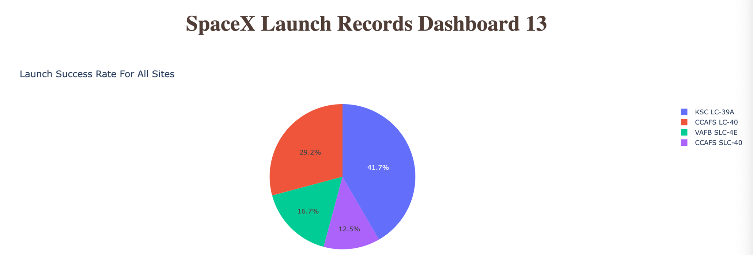
SpaceX Launch Records Dashboard
The dashboard indicates the success rates for each launch site
KSC LC-39a has had the most successful launches, whilst CCAFS SLC-40 has had the least.

Slide 40
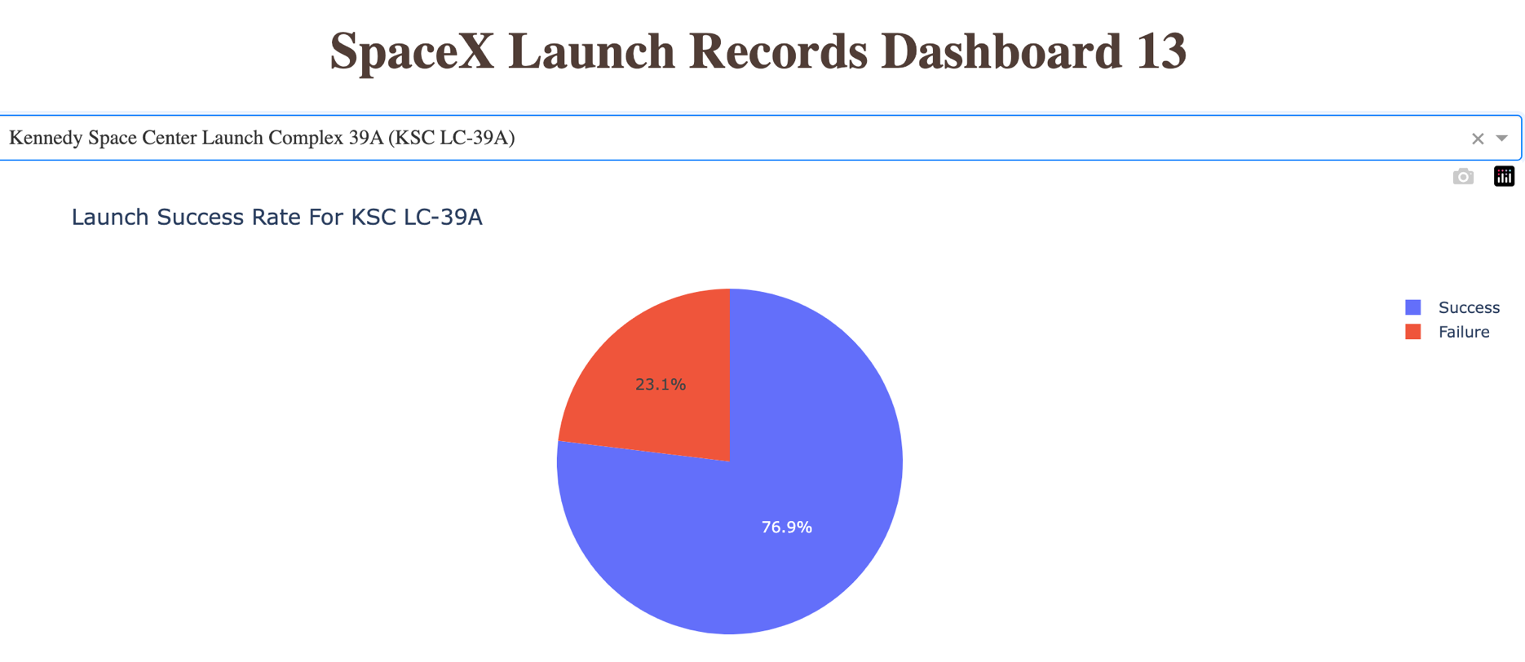
KSC LC-39a (Kennedy Space Centre) Success Rates
The data indicates that out of all launches from the Kennedy Space Centre, there is a 76.9% success score.

Slide 41
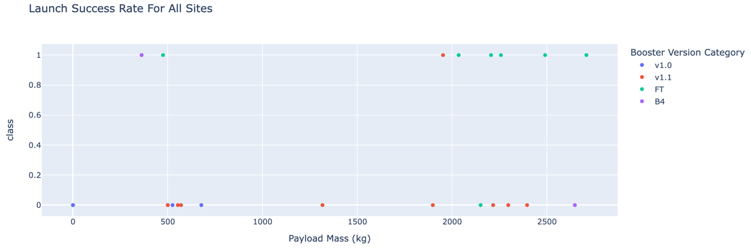
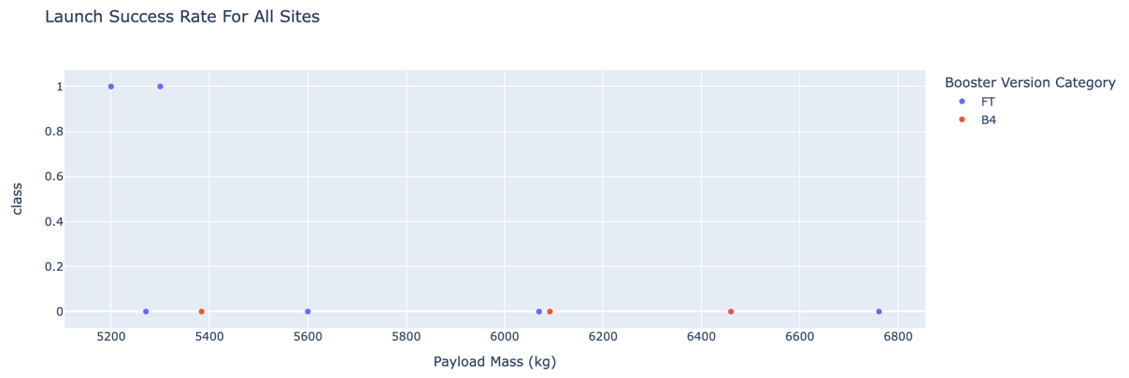
Missions for all Launch Sites by Payload
The scatter plots below from the dashboard indicate the payloads (that can be altered by the range slider) against the success and booster version
Missions for all Launch Sites with Payloads < 3000 kg
Missions for all Launch Sites with Payloads between 5000 and 8000 kg

Slide 42

Section 5

Slide 43
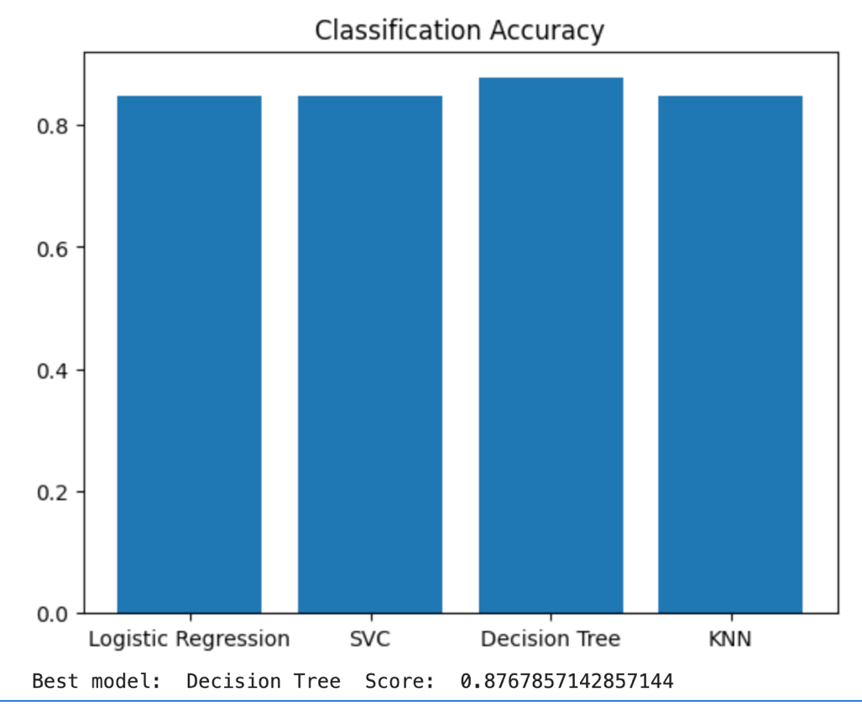
Classification Accuracy
Four classification models were tested against the data for fit
The results are very close with success percentages all over 83%
The DecisionTree Classifier was the most accurate model

Slide 44
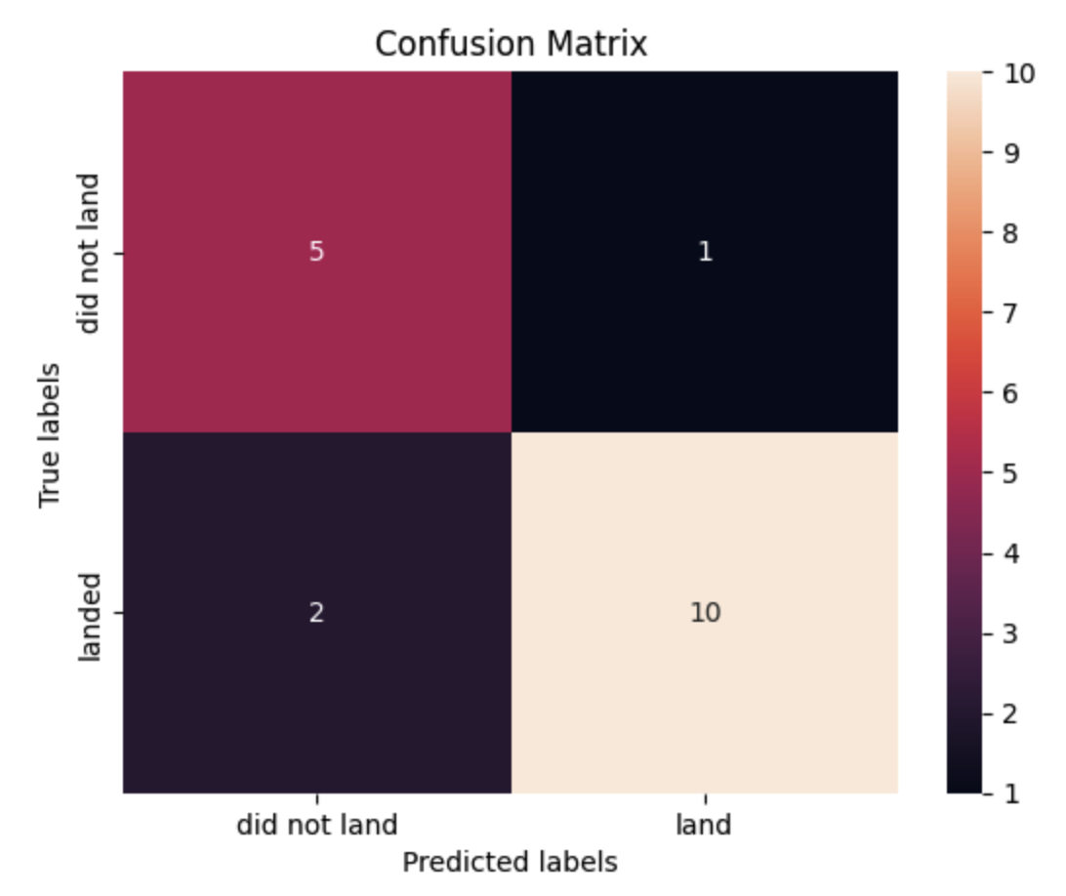
Confusion Matrix
The confusion matrix for DecisionTreeClassifier is shown on the right
There is an issue with the prediction of did not land, with the launch actually landed.

Slide 45
Conclusions
Based on the analysis the following has been concluded:
Launch success has been increasing steadily over since 2013
The Kennedy Space Centre has had the highest number of successful launches
The Decision Tree Classifier is the best algorithm to use for this data
Some orbits have a higher success rate than others.

Slide 46
Appendix
No additional documents added

Slide 47


